Slide 1
Deep History Of the Study of Haptic Perception
By: Ahmed Nadeem

Slide 2


Slide 3


Slide 4
Warning
- Background Color indicates progression through time
- black = past
- shades of blue = recent history
- white = now
BCE and Middle ages
Recent History
Present Day

Slide 5
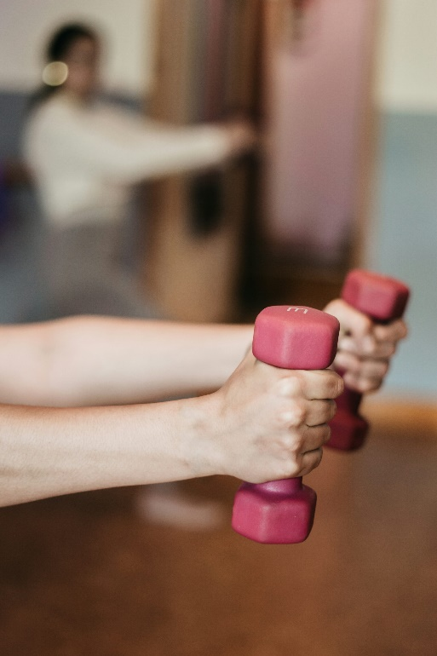
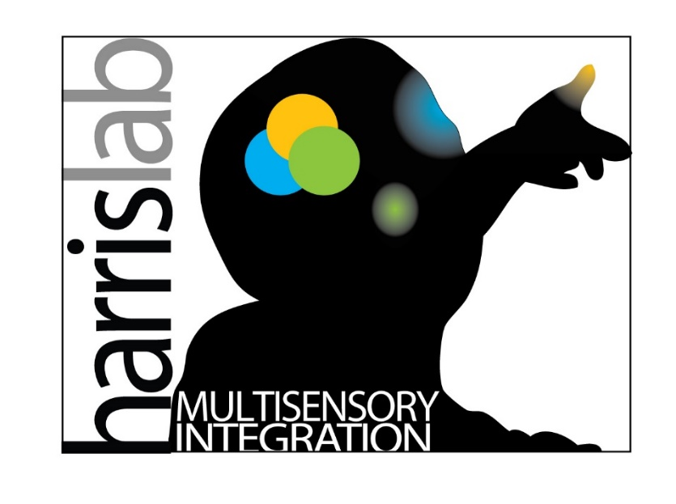

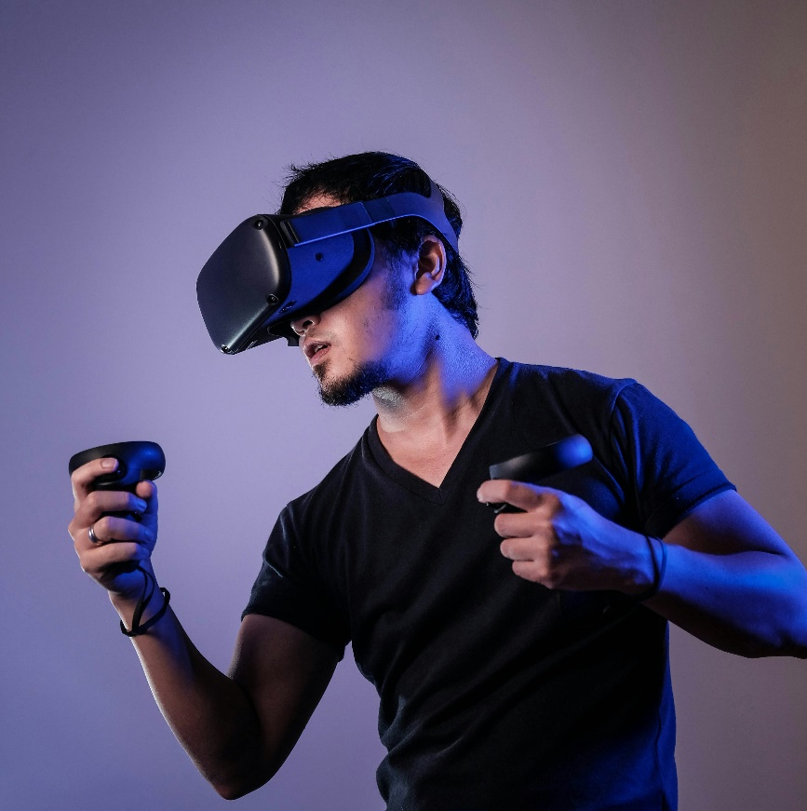
Content / Biological Topic
Before we begin
Notes:
Give a run down of who you are and what you do
I study haptic sense perception at the Dr. Laurence Harris Lab (psych prof really)
This means I study a lot of, how do people understand and process what they touch, and ONLY what they touch, not what they SEE and TOUCH. That isn’t me
I plan to study haptic perception mainly in the hands, but I want to be able to study it across the body and across space and MAYBE lower appendages (maybe). -> ill get back to this
The purpose of this work, for those who are curious is to develop better VR and AR experiences and make these systems for the future more refined and better suited for human use and exploration.
Or if not applicable there, then we can at least develop treatments and more advanced methodologies in diagnosing diseases or better assessments of human ability for various hand based experinces. Like, how well can your doctor place a robot arm at a specific point, to consider

Slide 6
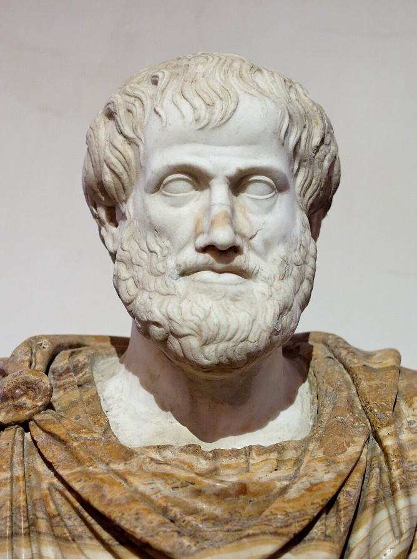
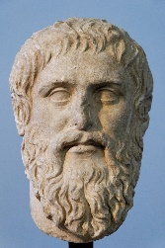
Ancient Philosophers - Sense
Intellect and perception?
Plato
(430 BCE – 350 BCE)
Empiricism
Perception?
Distinction Between Sensation and Perception
Senses?
Theory of forms
Knowledge?
Aristotle (380 BCE – 320 BCE)
Notes:
- go over and study these ideas
Theory of forms (we cant see real reality)
Empiricism -> sensory knowledge is what we have to study reality
-- plato was basically like, wahat is senses, what is perception, what does it mean to have knowledge of the world.

Slide 7
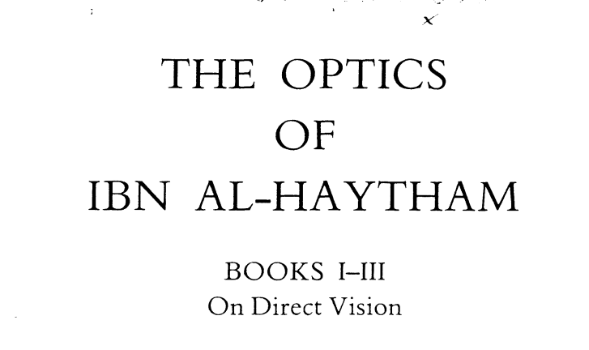

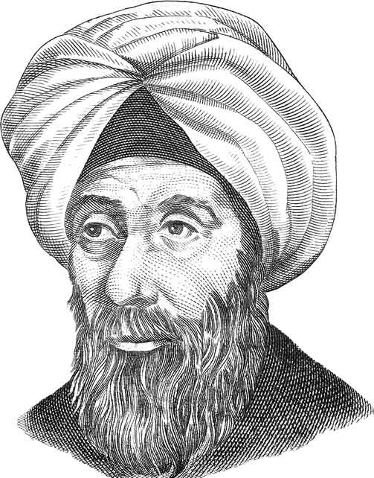
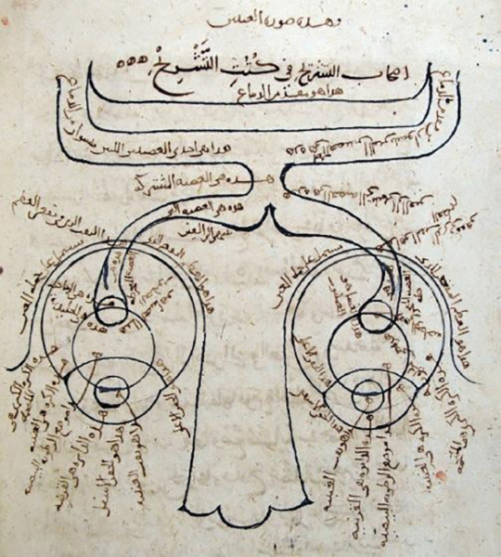
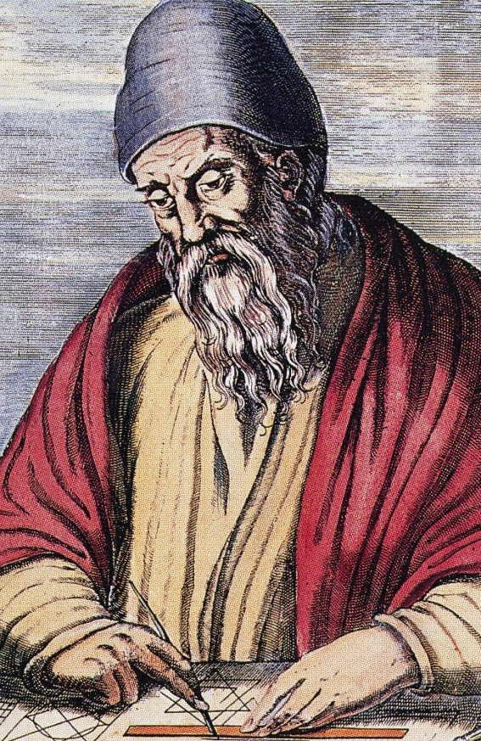
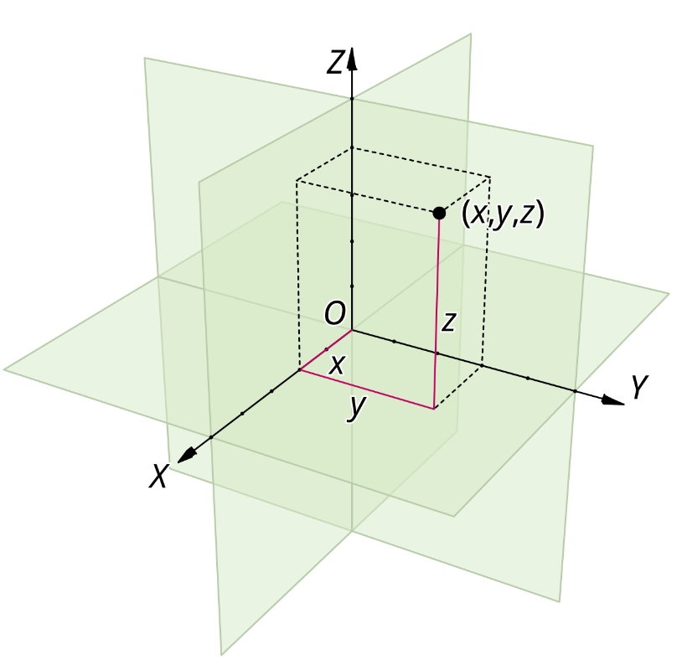
Ancient Philosophers PT.2
Euclid
(300 BCE)
Ibn Al-Haytham (1000 CE)
Notes:
Next we have Euclid, and im only covering really important people and ideas, or people who will be reference a lot later on,
Eculid is the most amazing vcuz he defineid and made the concept of euclidan space real, and something that we can discuss and work around / with
Ibn al-haytham, he came almost 1000 years later but was the first studier of optics, geometrically and also of human vision and biology, showing here the optic chasm
The reason I skipped 1300 years is cuz, there isn’t much too important, even tho this is a deep histoy, a lot of the elemnts im explaning now are relelvant to what im going to say, instead of relelavnt to psyophysics, biological psychology etc

Slide 8

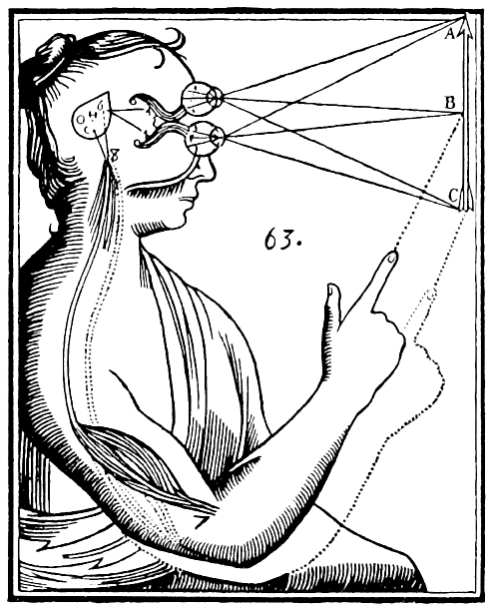
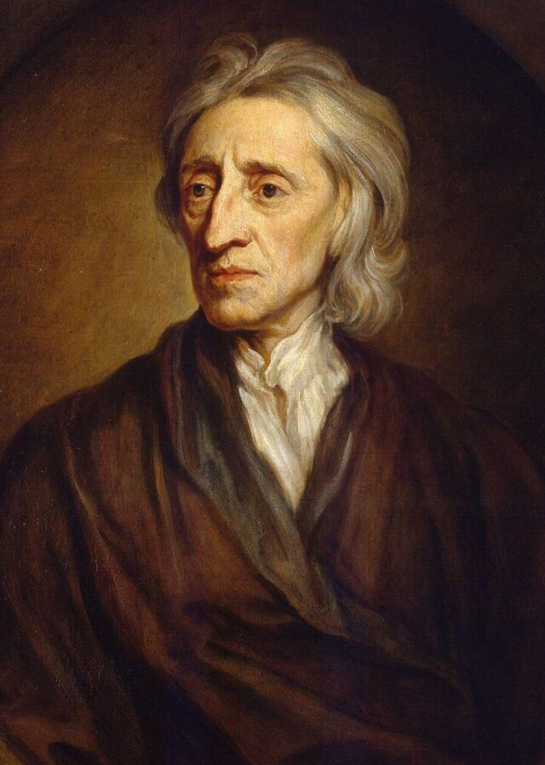
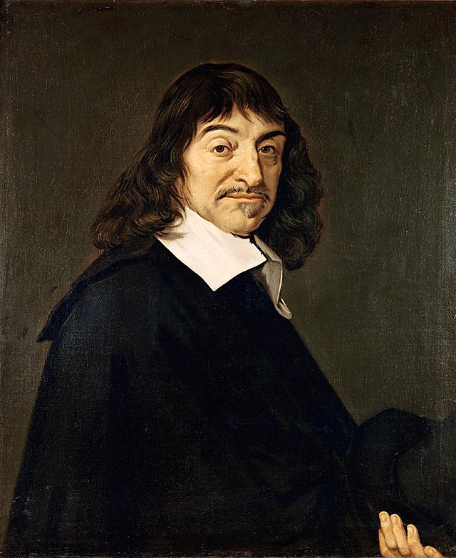

Pre Scientific revolution – 1800
John Locke (1632–1704)
Empiricism
Start of the
Scientific method
René Descartes (1596–1650)
Notes:
Relate back to science please -> scientific method started here + psychologyical foundcations

Slide 9
Pre Scientific revolution – 1800
PEOPLE STARTED TO THINK
WHAT ARE SENSES
WERE THE GREEKS RIGHT?
WHAT IS KNOWLEDGE?
WHAT IS
Notes:
Relate back to science please -> scientific method started here + psychologyical foundcations

Slide 10
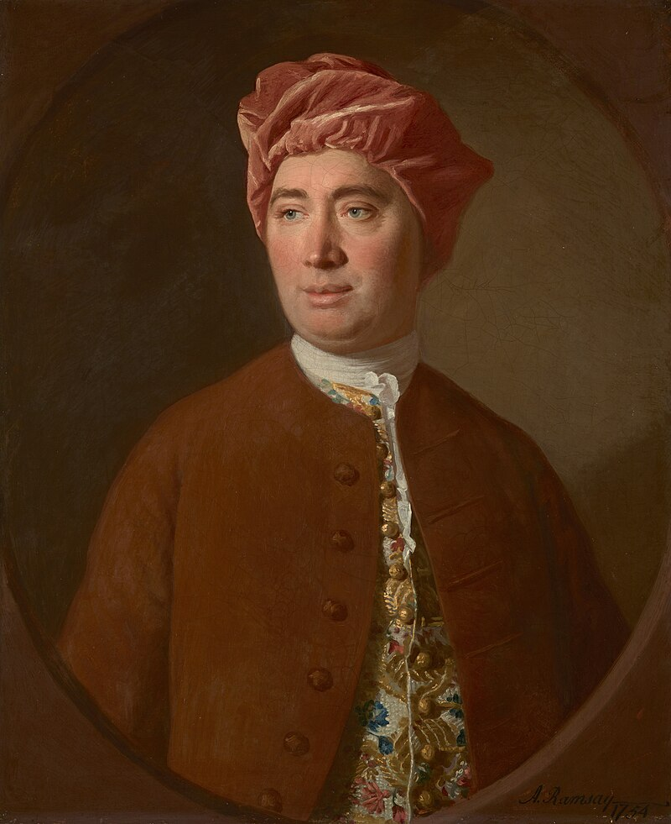
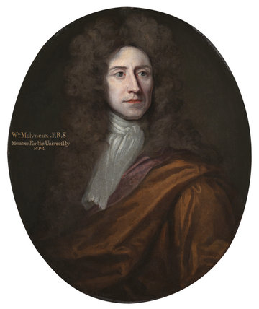
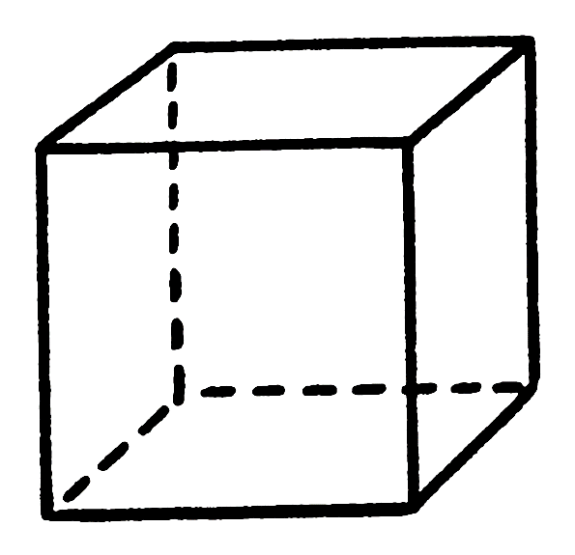
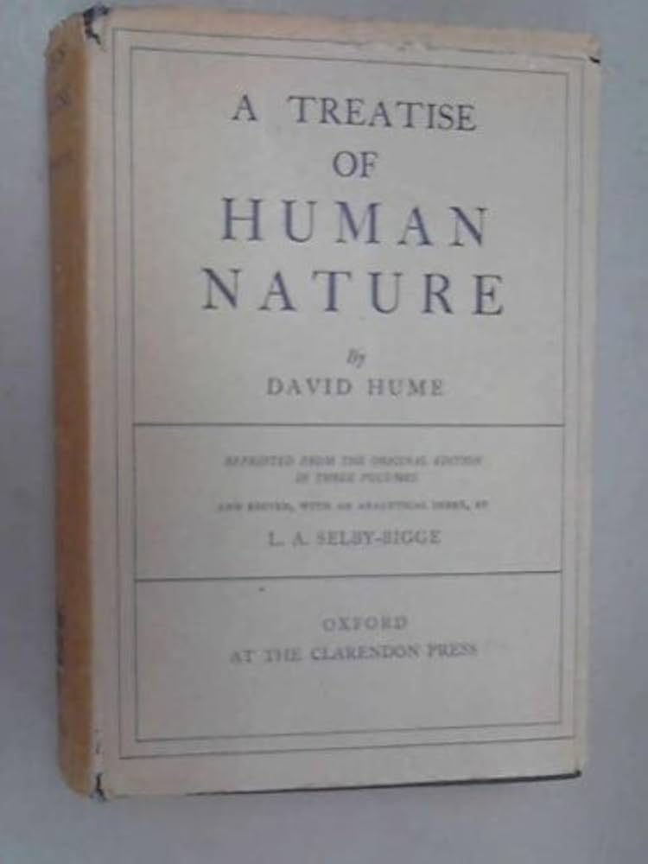
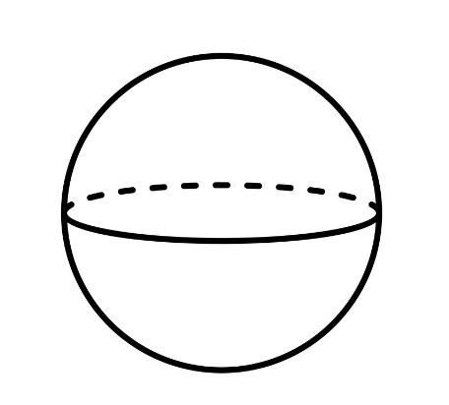
Pre Scientific revolution – 1800
William Molyneux (1656–1698)
David Hume (1711–1776)

Slide 11
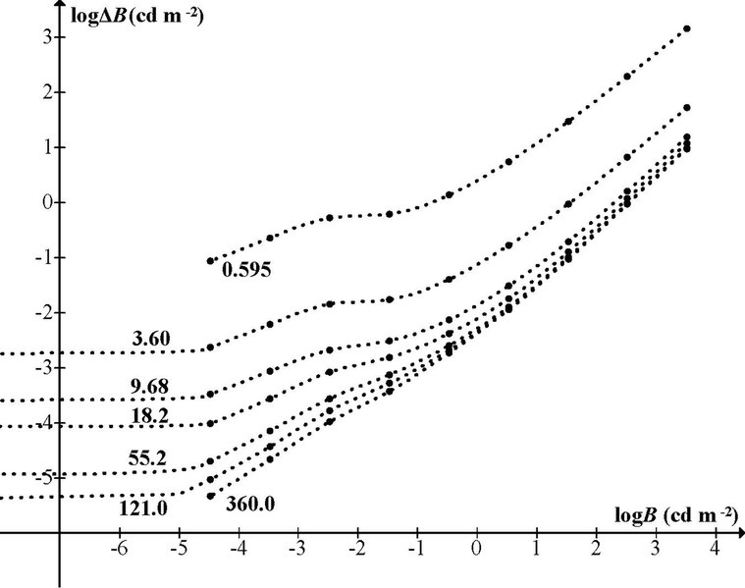
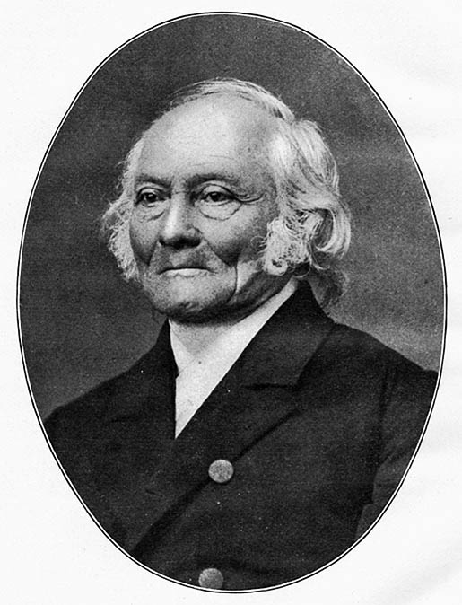
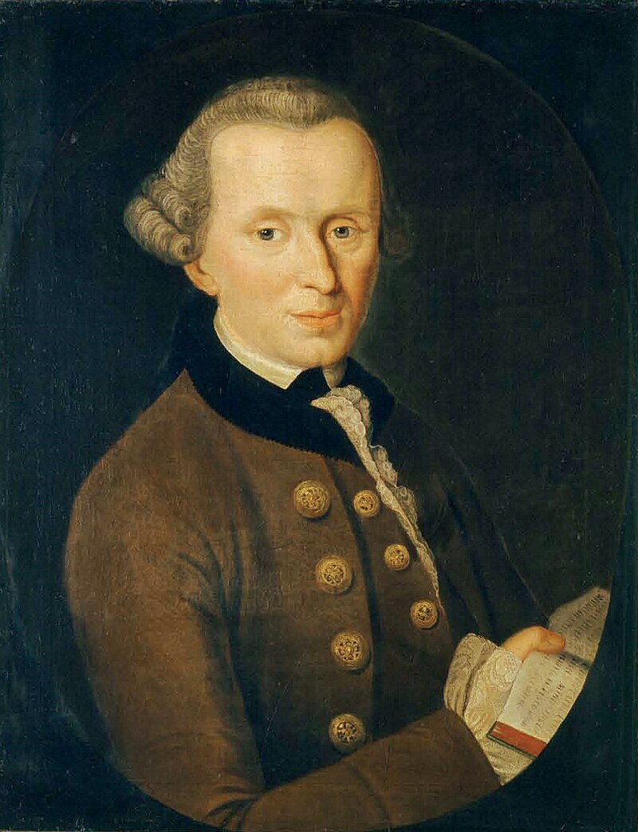
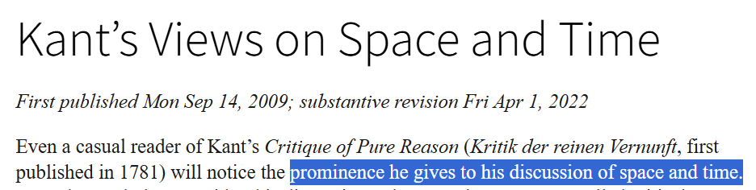
Pre Scientific revolution – 1800s
Ernst Heinrich Weber (1795–1878)
Immanuel Kant (1724–1804)

Slide 12
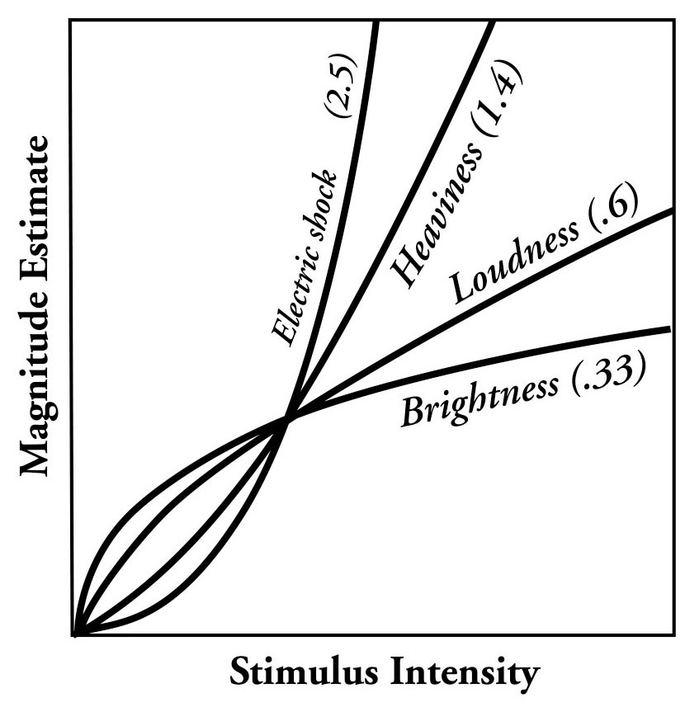
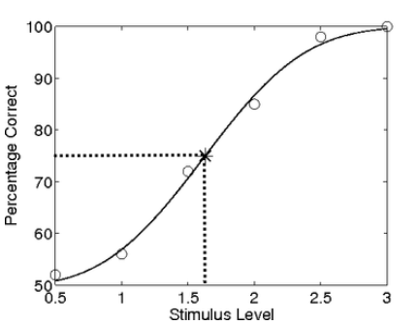
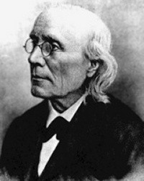
Pre Scientific revolution – 1800s
Gustav Fechner (1801–1887)

Slide 13
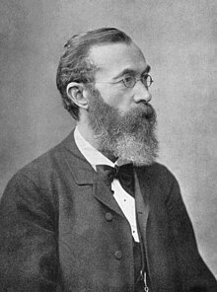
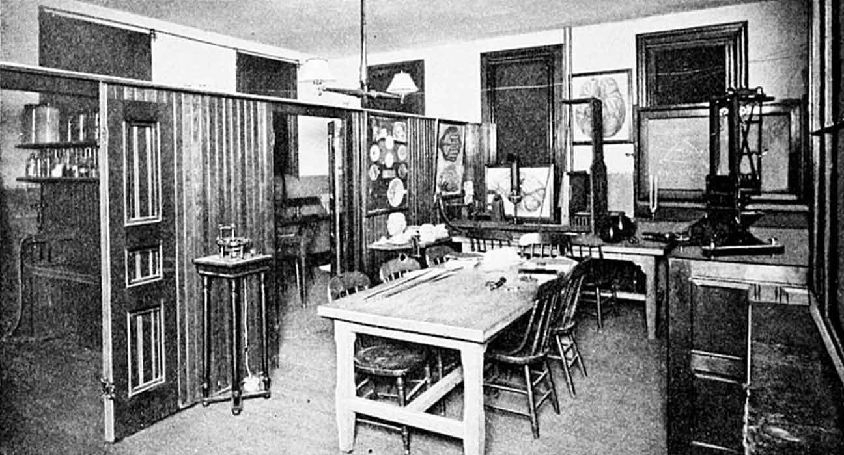
1800s onwards
Notes:
Whilem Wudnt

Slide 14
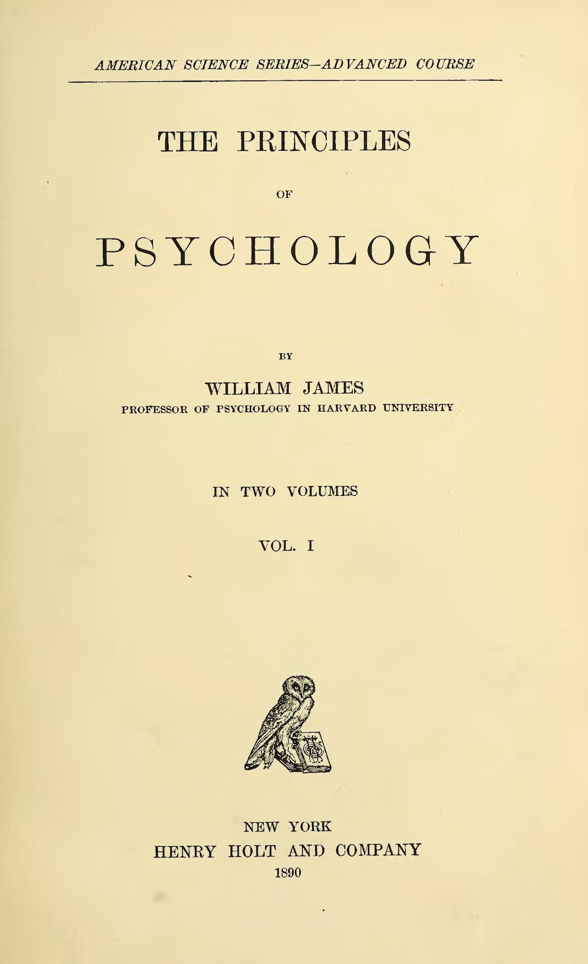
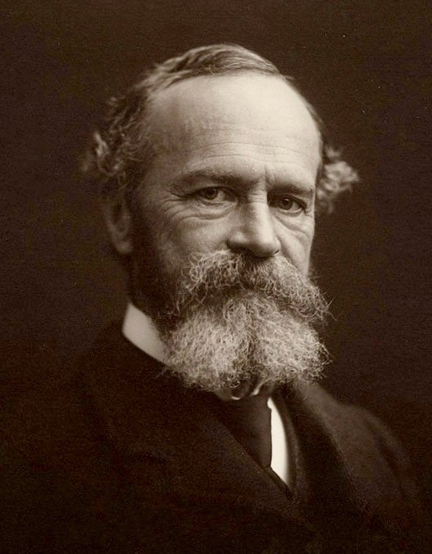
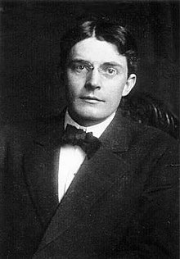
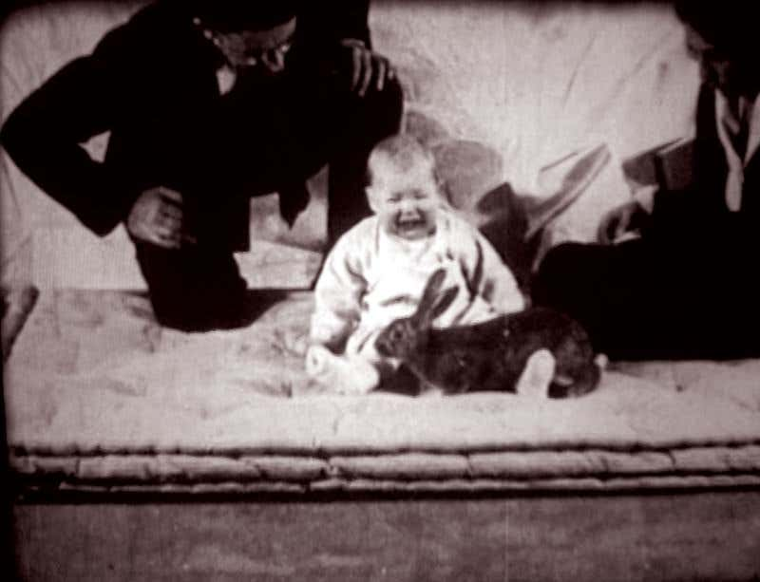
1800s onwards

Slide 15
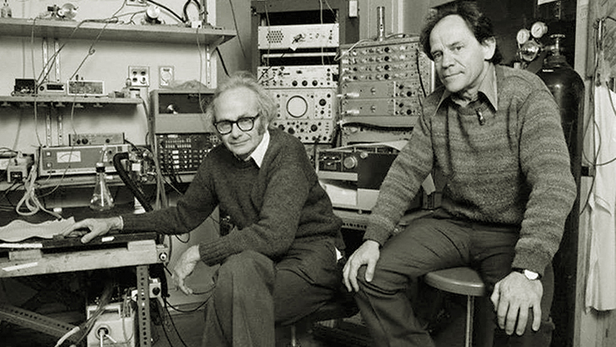
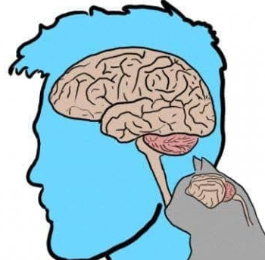
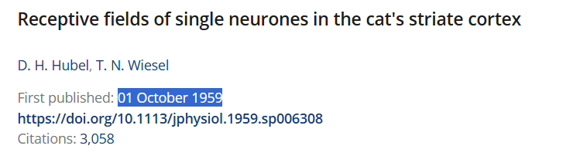
1900s-1950s onwards
Behaviorism/Psychology
Philosophy/Math
Physiology?
Notes:
- The older guyt, david hubel, acc made the tungsten electonde

Slide 16
1900s-1950s onwards
Behaviorism/Psychology
Philosophy/Math
Physiology?

Slide 17
1950s-1999
Behaviorism / Psychology
Biology
Philosophy / Math
Computers
Physiology?

Slide 18
1950s-1999
- Gibson - ecological optics
Daivid marr – computatiooal neuroscience and vision
Melyvn goodale -> visual strea hpyothsisis
Ian P howard
Susan Lederman (born 1944) and Roberta Klatzky (born 1947): Their collaborative work on haptic perception and object recognition has been prominent since the 1980s and continues to influence the field.

Slide 19
2000s-Present
- ml kappers
- harris

